Slide 1
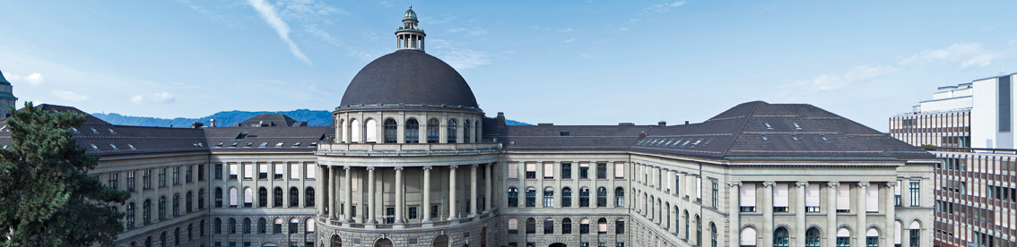
Reconstructing the World* in Six Days *(As Captured by the Yahoo 100 Million Image Dataset)
3D Vision Paper Presentation by Varin Buff, Gian-Andrea Heinrich, Björn Joos, Robin Stähli
Notes:
Jared Heinly, Johannes L. Sch¨onberger, Enrique Dunn, Jan-Michael Frahm Department of Computer Science, The University of North Carolina at Chapel Hill

Slide 2
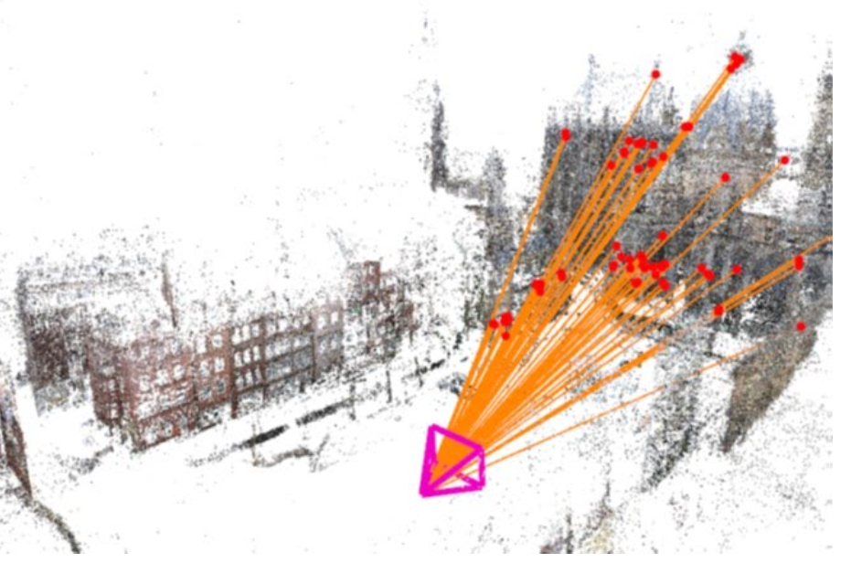
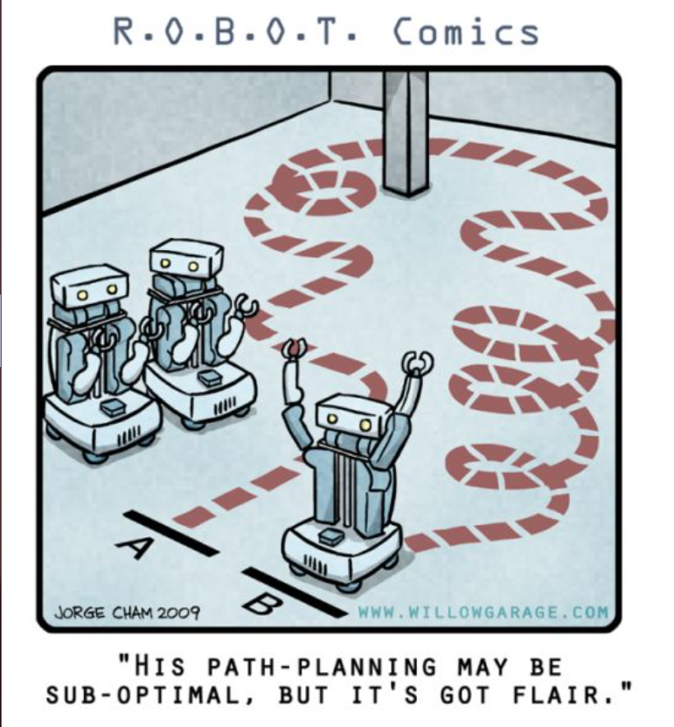
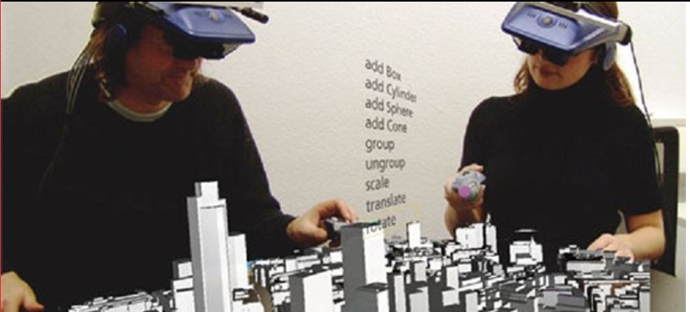
Why is it important?
Major Goal over Decades
Tremendous Amount of Image Data
Fast Increasing
Many Applications
Virtual Reality
Image Based Localization
Autonomous Navigation
Etc.
Notes:
Modeling the world from images has been a major Goal for Computer Vision
Fast growing. (Approx 10% of all pics were made last year)
KURVE MIT BILDER SUCHEN

Slide 3
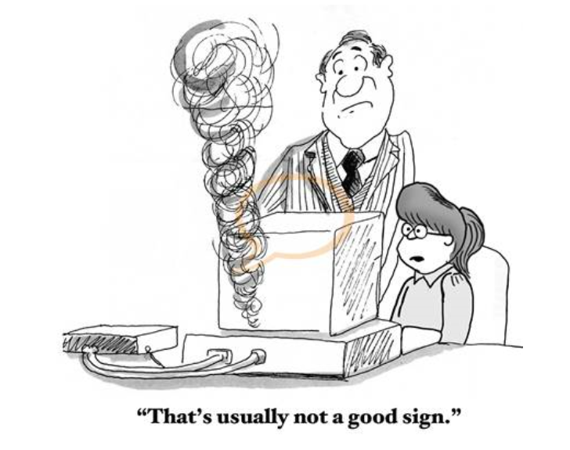



Challenges
Data Robustness
Compute & Storage Scalability
Registration Comprehensiveness
Model Completeness
Notes:
• Data Robustness: Enable the modeling from unorganized and heterogeneous Internet photo collections. • Compute & Storage Scalability: Achieve efﬁciency to meet the true scale of Internet photo collections
• Registration Comprehensiveness: Identify as many camera-to-camera associations as possible.
• ModelCompleteness: Build3Dscenemodels that are as extensive and panoramic as possible.

Slide 4
Related Work – Achievements and Challenges
 | Year | Achievements | Challenges | #Images
Frahm et al. | 2010 | Arguably the most scalable approach | Compromises in model completeness | 10^6
Agarwal et al. | 2011 | Image recognition by retrieval-based overlap detection | High Computing Power needed | 10^5
 | Year | Achievements | Challenges | #Images
Frahm et al. | 2010 | Arguably the most scalable approach | Compromises in model completeness | 10^6
 | Year | Achievements | Challenges | #Images
Frahm et al. | 2010 | Arguably the most scalable approach | Compromises in model completeness | 10^6
Agarwal et al. | 2011 | Image recognition by retrieval-based overlap detection | High Computing Power needed | 10^5
Havlena et al. | 2014 | Significant increase in performance | Large memory consumption → not scalable | 10^6
 | Year | Achievements | Challenges | #Images
Frahm et al. | 2010 | Arguably the most scalable approach | Compromises in model completeness | 10^6
Agarwal et al. | 2011 | Image recognition by retrieval-based overlap detection | High Computing Power needed | 10^5
Havlena et al. | 2014 | Significant increase in performance | Large memory consumption → not scalable | 10^6
Klingner et al. | 2016 | Image overlap detection on World-scale | Known geolocation needed, Sparse model | Google Street View
 | Year | Achievements | Challenges | #Images
Frahm et al. | 2010 | Arguably the most scalable approach | Compromises in model completeness | 10^6
Agarwal et al. | 2011 | Image recognition by retrieval-based overlap detection | High Computing Power needed | 10^5
Havlena et al. | 2014 | Significant increase in performance | Large memory consumption → not scalable | 10^6
Klingner et al. | 2016 | Image overlap detection on World-scale | Known geolocation needed, Sparse model | Google Street View
Nister et al. | 2006 | Features to “words” Introduction of Vocabulary Tree | - | -
Notes:
Frahm et al. LS-SfM and dense reconstruction from city-scale Internet photo collections of millions of images on a single PC in less than 24 hours. Their approach used a binary appearance representation to derive an iconic scene representation for efﬁcient registration and SfM.
Agarwall:
Their method similarly leveraged the beneﬁts of image recognition through retrieval-based image overlap detection.
Havlena propose to circumvent feature matching and pairwise image veriﬁcation altogether by using vocabulary-tree-based image retrieval as the correspondence mechanism. Each image pair with sufﬁcient overlap in its visual words is then directly used as an overlapping pair for the reconstruction.
fKlingneretal.[16],where Google StreetView images are used to enable a world-scale reconstruction. This method circumvents the challenging problem of image overlap detection and connected component discovery at world-scale by exploiting the known geolocation to perform windowed bundle adjustments for pose reﬁnement for the cameras

Slide 5

Novelties – Improvements
Higher Performance
Scalable
State of the Art Model Completeness
No Geo-Location

Slide 6
WS-SfM – Image
Hard
Disk
Raw
Images
Normalized Images
SIFT
Visual Words
Notes:
As you just heard, image collections are getting bigger and bigger, so how does WS-SfM work?
The images are loaded batch wise from the hard drive.
The images are then normalized and resized to the resolution of 640 x 480
Following the SIFT algorithm is applied to extract the features
But also a visual Words representation is generated

Slide 7
WS-SfM – Iconic vs. Attached Images
Iconic Images
Attached Images
Image Clusters if “c” bigger than 3
Notes:
But what is the system chosen to save the images?
The Idea is simple. For every scene a Iconic Image is created, if other images match with the iconic image they are connected. If three images are connected, they are merged together to a cluster.

Slide 8
WS-SfM – Case 1 – No Iconic Image Match
New Iconic Image
Visual Words
Vocabulary Tree Containing Clusters
Notes:
The visual words are then stored in a vocabulary tree. Therefore the new visual words search there k nearest neighbours in the Vocabulary tree.
There are three cases that could happen. Case one: The new image doesn’t fit to any other image. This leads to a new iconic image.

Slide 9
WS-SfM – Case 2 – One Iconic Image Match
Attached Image
Visual Words
Vocabulary Tree Containing Clusters
Notes:
If a new image is matched to another iconic cluster it will be attached. This match is verified with the ARRSAC algorithm. The visual words of the new image will also be added to the iconic image.
Adaptive Real-Time Random Sample Consensus (ARRSAC)

Slide 10
WS-SfM – Case 3 – More than One Iconic Image Match
Attached Image
Attach Image to best matching Iconic Image
Join matched Cluster into Component
Visual Words
Vocabulary Tree containing Clusters
Notes:
The last case is the most important one: If the New visual words match to more than one Cluster it will be attached to the best match, but the cluster are now joined into a connected component.

Slide 11
WS-SfM – Data kept from Images
SIFT Features
Visual Words
Camera Intrinsics
Notes:
What we are left with are the following three informations: the SIFT features, te Visual words and the camera intrinsics.

Slide 12
WS-SfM – Cluster Merging
Problem: Two or more clusters can be similar
Solution: Merging
Merging Clusters

Slide 13
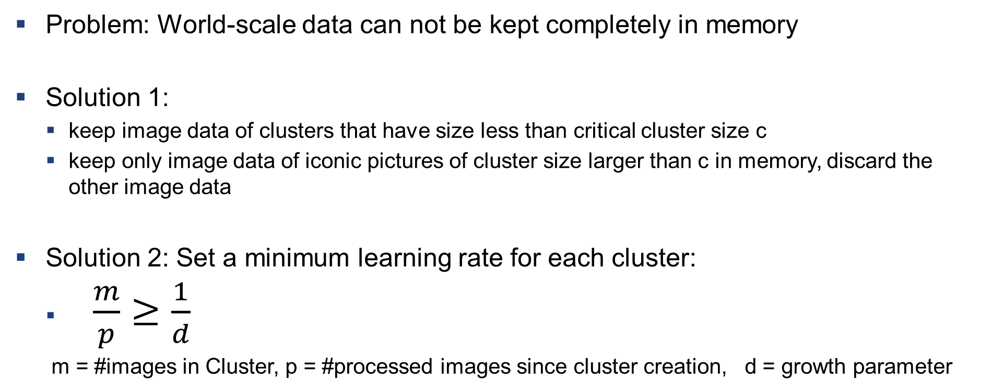
WS-SfM – Data Management
Problem: World-scale data can not be kept completely in memory
Solution 1:
keep image data of clusters that have size less than critical cluster size c
keep only image data of iconic pictures of cluster size larger than c in memory, discard the other image data
Solution 2: Set a minimum learning rate for each cluster:
$\frac{m}{p}≥\frac{1}{d}$
m = #images in Cluster, p = #processed images since cluster creation, d = growth parameter

Slide 14
WS-SfM – Structure From Motion (SfM)
Search for connections
Skeletal SfM of Scene
Register remaining connecting images with P3P
iconic images
search for connections
connecting Images

Slide 15
Evaluation – Setup
Different datasets:
Roman Forum ~ O(10⁵)
Berlin ~ O(10⁶)
Paris ~ O(10⁶)
London ~ O(10⁶)
World by Yahoo ~ O(10⁸)

Slide 16
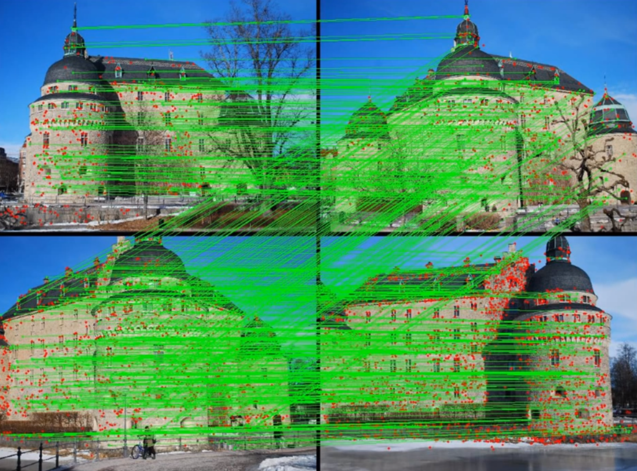
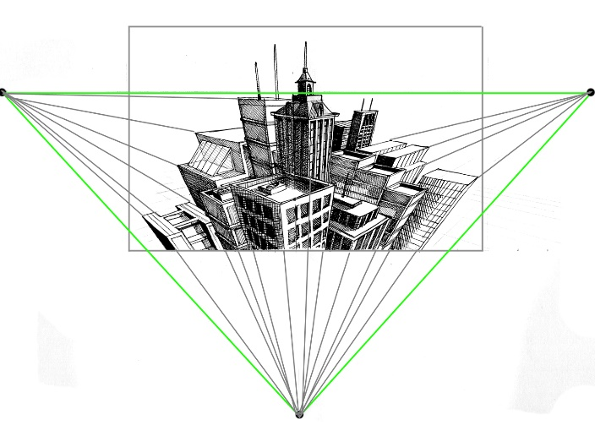
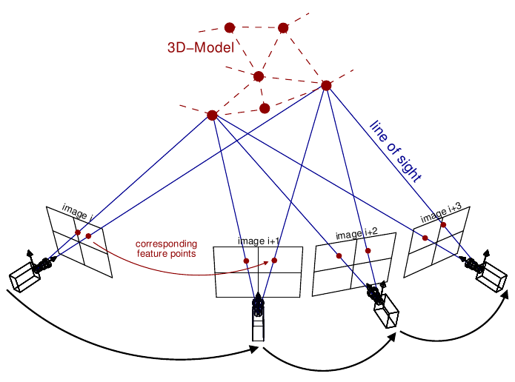
Evaluation – Setup
Different datasets:
Roman Forum ~ O(10⁵)
Berlin ~ O(10⁶)
Paris ~ O(10⁶)
London ~ O(10⁶)
World by Yahoo ~ O(10⁸)
Image match algorithm:
>= 30 inliner matches
Ignore images if > 70% of inliners are along the outer boarder (watermarks)
Positioning camera in existing 3D model requires >= 50 P3P

Slide 17
Evaluation – Benchmark → Improvements
Results & Comparison:
Roman Forum (MatchMiner)
~4.7x faster (PC vs 53-node cluster)
More images (~ +11.7%)
~1.5x better connectivity
Berlin (Frahm et al.)
~14x faster
~2x more registered photos
Berlin/London/Paris:
Registration rate of ~25%
Computation rates scale linearly
State-of-the-art model completeness
Improvements:
7 high-performance HDDs
Render down to 640x480 pixels
Use >5x memory
More powerful GPUs
Bottleneck: Harddrive too slow

Slide 18
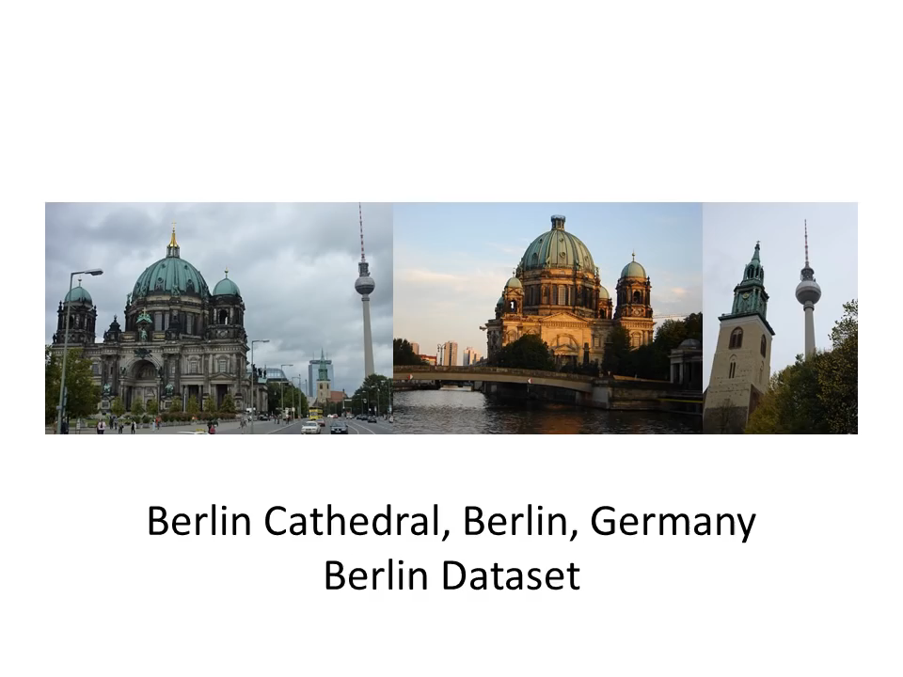
Evaluation – World Results

Slide 19
Conclusion
Achievements:
State of the art model-completeness
First to handling unordered world-scale datasets
~100 Mio images processed to 3D models within 6 days
While at the same time being
Modular
Online (streaming, on the fly)
Scalable (linear processing time)
Future research:
Streaming
Associating data (on the fly) is more difficult
Higher model completeness
New data association concepts
Critics:
Not reconstructing the world
Ignoring unmatched images after a defined period
Only matched ~1.5% of all images

Slide 20


Slide 21
References
Heinly, J., Schonberger, J.L., Dunn, E., Frahm, J.M., and Ieee: ‘Reconstructing the World* in Six Days *(As Captured by the Yahoo 100 Million Image Dataset)’, in Editor (Ed.)^(Eds.): ‘Book Reconstructing the World* in Six Days *(As Captured by the Yahoo 100 Million Image Dataset)’ (Ieee, 2015, edn.), pp. 3287-3295
http://nerei.org/wp-content/uploads/2016/07/Nerei-Virtual-reality-Environments-612x278.jpg (13.08.2018)
https://cdn.instructables.com/FMK/1ZLS/J283520X/FMK1ZLSJ283520X.MEDIUM.jpg (13.08.2018)
https://www.frsco.com/completeness/ (15.03.2018)
https://sites.google.com/site/yorkyuhuang/_/rsrc/1455602233247/home/research/computer-vision-augmented-reality/image-based-relocalization-in-slam/image_camerapose.jpg (13.08.2018)
http://www.cartoonresource.com/archive/education-teachers/teaching/computer-is-smoking.aspx (13.08.2018)
Frahm, J.M., Fite-Georgel, P., Gallup, D., Johnson, T., Raguram, R., Wu, C.C., Jen, Y.H., Dunn, E., Clipp, B., Lazebnik, S., and Pollefeys, M.: ‘Building Rome on a Cloudless Day’, Computer Vision-Eccv 2010, Pt Iv, 2010, 6314, pp. 368-381
Agarwal, S., Furukawa, Y., Snavely, N., Simon, I., Curless, B., Seitz, S.M., and Szeliski, R.: ‘Building Rome in a Day’, Commun. ACM, 2011, 54, (10), pp. 105-112
Nister, D., and Stewenius, H.: ‘Scalable Recognition with a Vocabulary Tree’, in Editor (Ed.)^(Eds.): ‘Book Scalable Recognition with a Vocabulary Tree’ (2006, edn.), pp. 2161-2168
Klingner, B., Martin, D., Roseborough, J., and Ieee: ‘Street View Motion-from-Structure-from-Motion’, in Editor (Ed.)^(Eds.): ‘Book Street View Motion-from-Structure-from-Motion’ (Ieee, 2013, edn.), pp. 953-960
Havlena, M., and Schindler, K.: ‘VocMatch: Efficient Multiview Correspondence for Structure from Motion’, Computer Vision - Eccv 2014, Pt Iii, 2014, 8691, pp. 46-60

Slide 22
Our Ideas to Reconstruct the World
Split the world in many coherent areas/datasets (e.g. cities)
Depending on image density
Geolocation
Process datasets separately
Neighbouring areas
Don’t “forget” images by running out of memory
Macro-scale: sorted
Micro-scale: unsorted

Slide 23
Open Questions
Tritratrallala

Slide 24
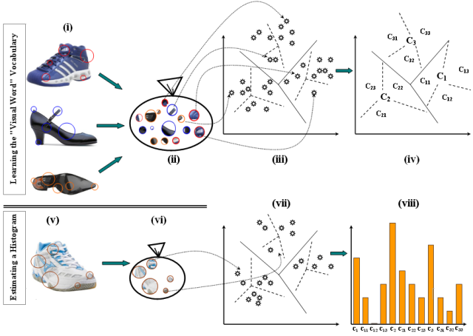
Vocabulary tree
Vocabulary tree is a compact way to do image retrieval. Vocabulary tree is something which is made by clustering visual words into clusters.

Slide 25
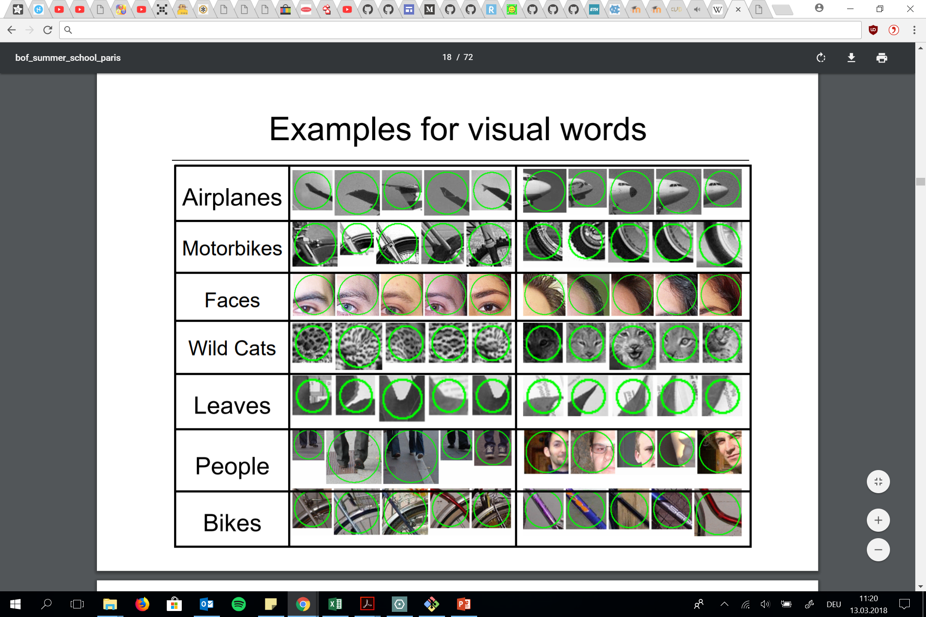
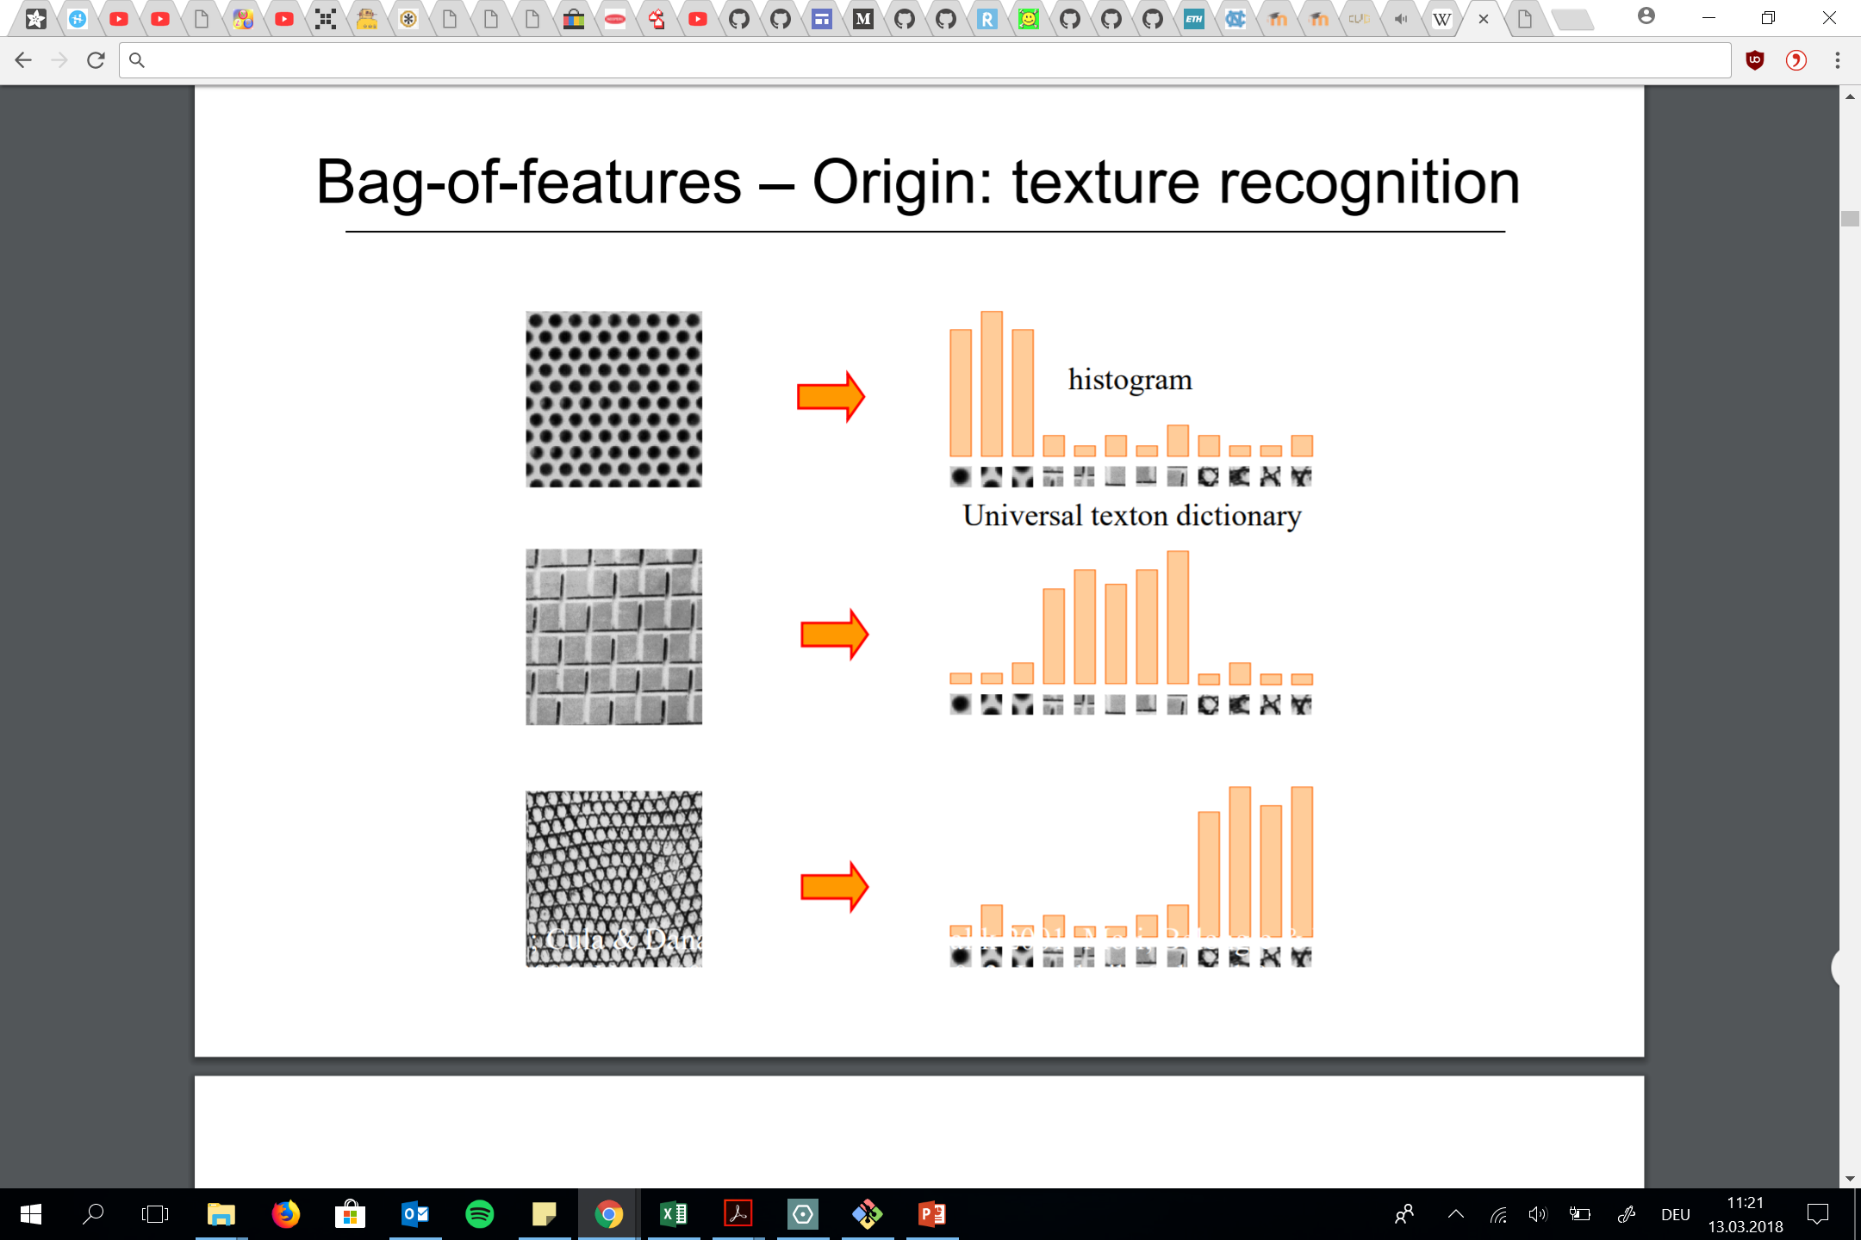
Problems
Texture is characterized by the repetition of basic elements or textons
http://www.di.ens.fr/willow/events/cvml2011/materials/CVML2011_Cordelia_bof.pdf

Slide 26
Evaluation – Benchmark → Improvements
Results & Comparison:
I/O Bottleneck: Harddrive too slow
Roman Forum (MatchMiner)
~4.7x faster (PC vs 53-node cluster)
More images (~ +11.7%)
~1.5x better connectivity
Berlin (Frahm et al.)
~2x more registered photos
~14x faster
Berlin/London/Paris:
Registration rate of ~25%
Computation rates scale linearly
State-of-the-art model completeness
Improvements:
7 high-performance HDDs
Render down to 640x480 pixels
Use >5x memory
More powerful GPUs

Slide 27
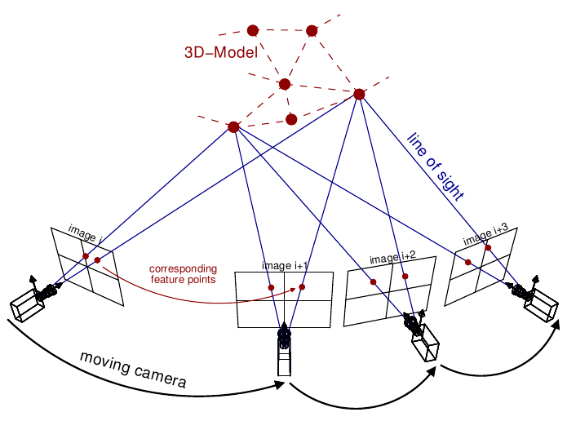
Evaluation
Split into 2 sections:
First one: Same PC as Frahm et al. [9] to check performance with the same small scale datasets
Second: Better PC: World
Different datasets:
Roman Forum
Berlin
Paris
London
World by Yahoo
Training Workflow and Diagramm of A3C high-level achitecture → Asynchronous Advantage Actor-Critic

